Slide 1
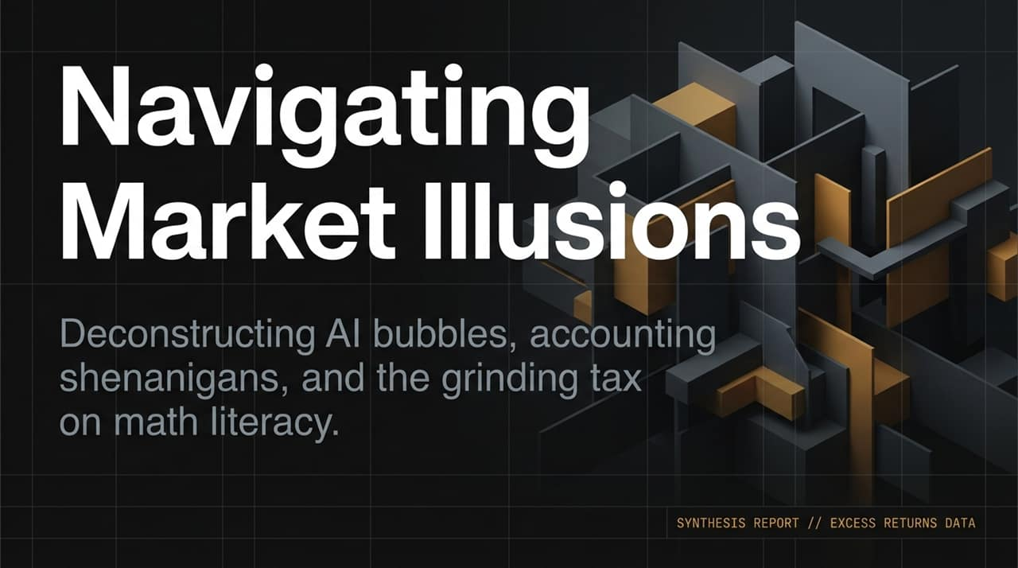
Notes:
Welcome, everyone. Today, we are walking through a synthesis of key insights analyzing the modern financial environment, specifically unpacking three major market illusions: Technological, Macro, and Behavioral.
As discussed in our recent analysis with market strategists Dan Niles, Ben Hunt, and Cameron Dawson, today's market is defined by a dangerous mix of genuine technological innovation alongside expanding structural and psychological blind spots.
Our goal today is to give you the tools to separate fundamental growth from cyclical accounting tricks, map how narratives change central bank credibility, and recognize subtle behavioral traps before they erode long-term wealth.
https://www.youtube.com/watch?v=ks0DhmOPTj8

Slide 2

Notes:
To understand where we are in the AI cycle, we have to look beyond a single monolithic 'AI hype' story and split it into three distinct phases: Training, Inference, and Agentic.
Dan Niles pointed out that on January 30th, the release and formalization of agentic frameworks (such as OpenClaw) marked a structural turning point.
Unlike early chat-based inference, Agentic AI uses 10x to 100x more compute/tokens because it executes multi-step autonomous workflows.
Because companies are just now beginning to realize actual, measurable ROI from these agentic workflows, capital expenditures are extending into a renewed cycle.

Slide 3
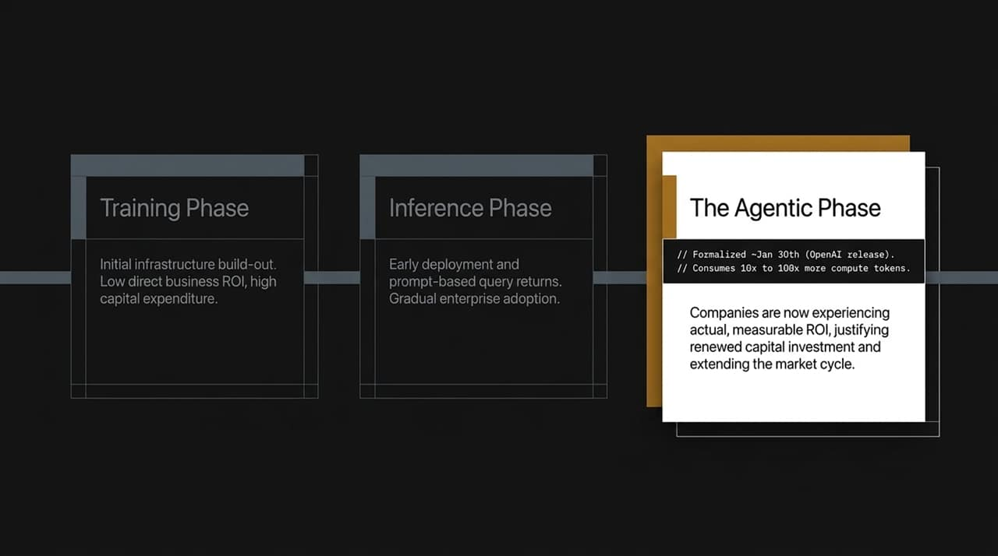
Notes:
Even during valid technology revolutions, market participants fall into the trap of believing that hyper-smart leadership immune-boosts a company from cyclical contractions.
Consider Cisco in May 2001. Cisco was widely regarded as the most valuable, dominant, and smartest company powering the backbones of the internet.
Yet, in just a few months, Cisco's CEO had to report a drop in bookings growth from +70% year-over-year to -30% year-over-year.
The takeaway today: Current hyperscalers driving AI infrastructure are exceptional businesses, but smart execution does not make them immune to sudden cyclical breaks. Hold strong convictions, but hold them loosely and watch the raw data like a hawk.

Slide 4
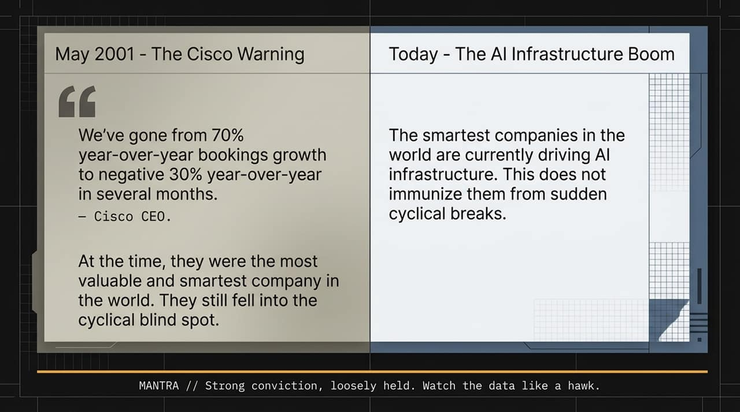
Notes:
Dan Niles aggressively challenged the dogma that 'buying and holding forever' is always the optimal strategy, calling unmanaged holding in single equities fundamentally flawed due to survivorship bias.
Financial media loves telling the story of the grandmother who put Apple or Microsoft in a drawer decades ago and became a millionaire.
They never highlight the grandmother who put AOL, Yahoo, Nokia, Cisco, or Enron into a drawer expecting the same outcome.
Even standard indices rebalance and reconstitute over time. Treating any single individual stock as a permanent, unmanaged legacy holding introduces severe cognitive risk to a portfolio.

Slide 5
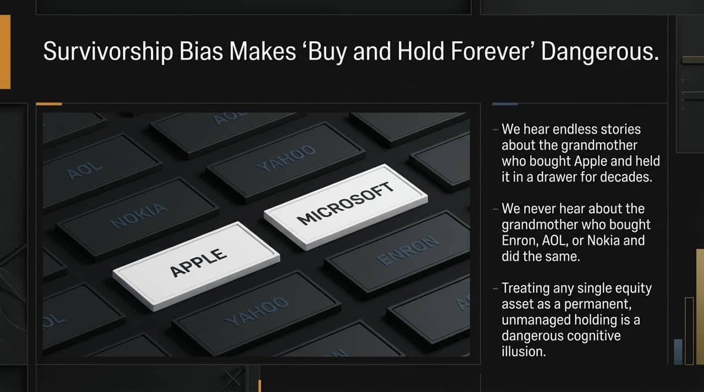
Notes:
Borrowing a concept from strategist Cameron Dawson and Howard Schilit's classic book Financial Shenanigans, accounting tricks do not show up early in an economic boom.
Accounting games are fundamentally cyclical. They proliferate most aggressively at the absolute apex or crest of a market cycle, right when underlying fundamental growth begins to decelerate.
When real organic demand slows, management teams face immense quarterly pressure to maintain the illusion of exponential growth, prompting them to turn the accounting 'knob' all the way up to 11 to push boundary lines across financial statements.

Slide 6
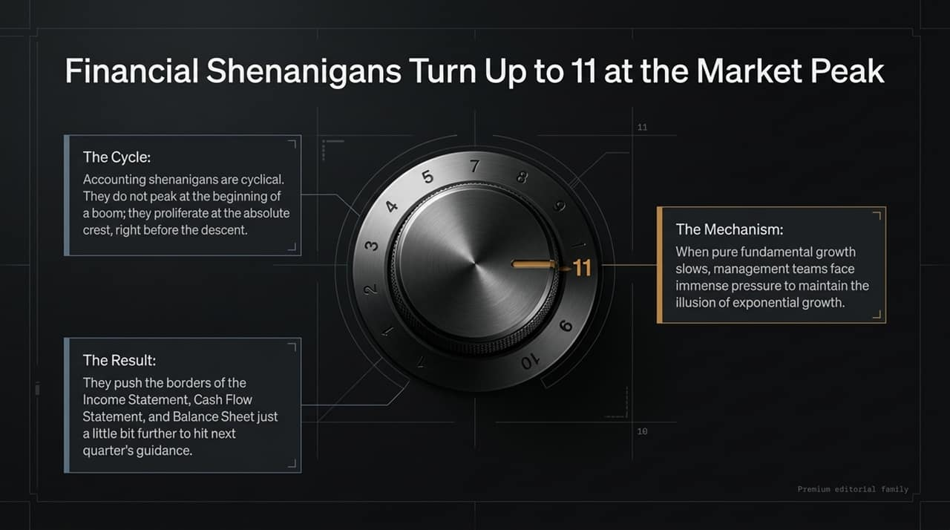
Notes:
"Let's look at how these games play out across financial statements today:
Circular Receivables/Payables: Nvidia extending accounts receivable terms to customers, while hyperscalers extend accounts payable, artificially flattering Free Cash Flow (FCF) metrics for customer balance sheets.
CapEx Reclassification: Microsoft lowering reported CapEx by shifting financing and operating leases out of core calculations to make their FCF look leaner and healthier.
SPVs & Equity Method Accounting: Taking massive stakes in private AI entities (e.g., Microsoft's stake in OpenAI) using equity method accounting and off-balance-sheet Special Purpose Vehicles (SPVs) to keep capital obligations hidden from headline GAAP metrics.

Slide 7
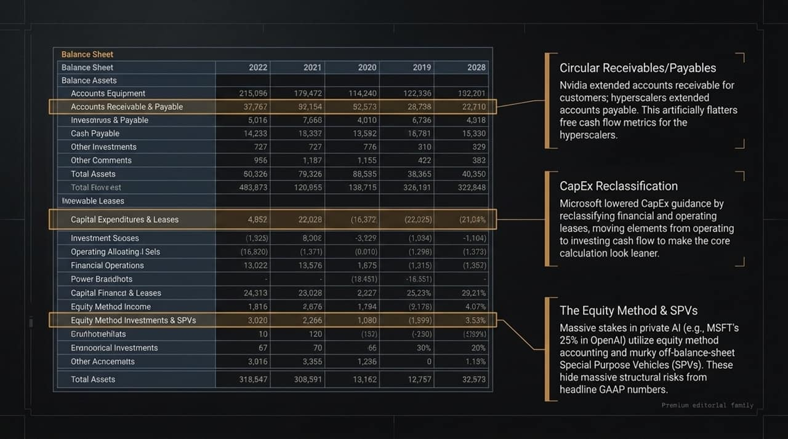
Notes:
Moving from technology to macroeconomics, Ben Hunt uses a powerful visual metaphor for central bank credibility: A teacup.
A institution's reputation or credibility is like a fine china teacup. If you chip it or crack it, you can carefully glue it back together, and it remains technically functional—but its structural integrity is permanently compromised.
When central banks talk aggressively about fighting inflation but hesitate or fail to take decisive policy action when given the window, market participants stop believing forward guidance. Once that trust shatters, words lose their power and only concrete action restores faith.

Slide 8

Notes:
Rather than relying on basic word-cloud sentiment analysis, we can track the semantic structure of news and language density across global media to map a narrative's life cycle.
"A narrative moves through 4 key stages:
Contested: Market participants actively debate whether a premise is true.
Supernova Burst: An event triggers a sudden spike in narrative density across media channels.
Confirmed: The consensus accepts the premise.
Common Knowledge: Reaches the state of 'what everybody knows that everybody knows'.

Slide 9
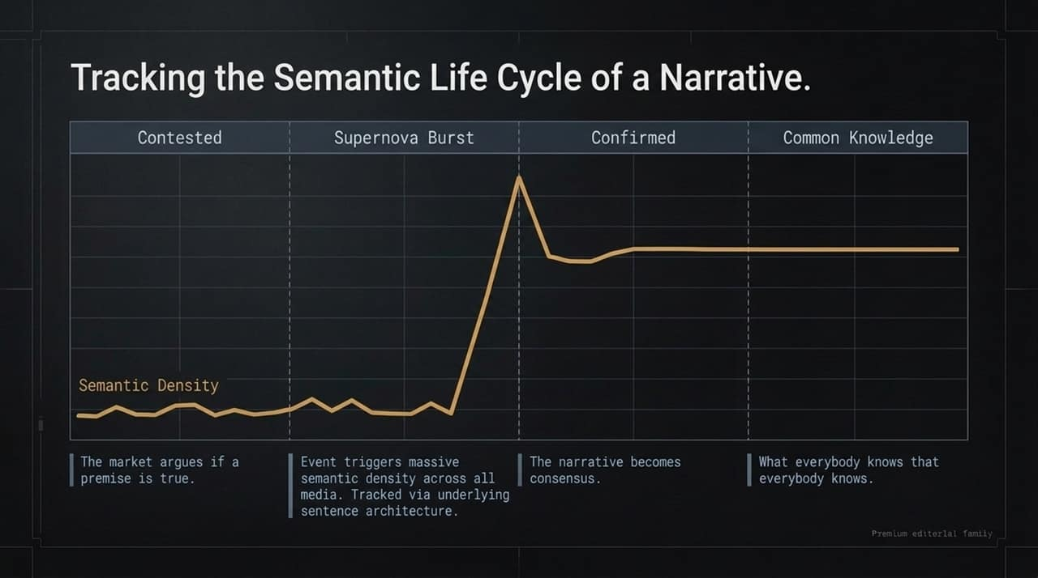
Notes:
Here is a real-world application of semantic tracking: mapping central bank credibility against hard assets like Gold.
Gold price can essentially be modeled as '1 divided by Trust in Fiat/Central Banks'.
When policy leaders talk hawkishly on inflation but fail to act decisively, a 'Supernova Burst' occurs in media narratives confirming a loss of central bank credibility.
As the narrative shifts to 'Meet the new boss, same as the old boss,' market pricing rapidly re-adjusts, sending hard assets like Gold surging higher in direct response to compromised trust.

Slide 10
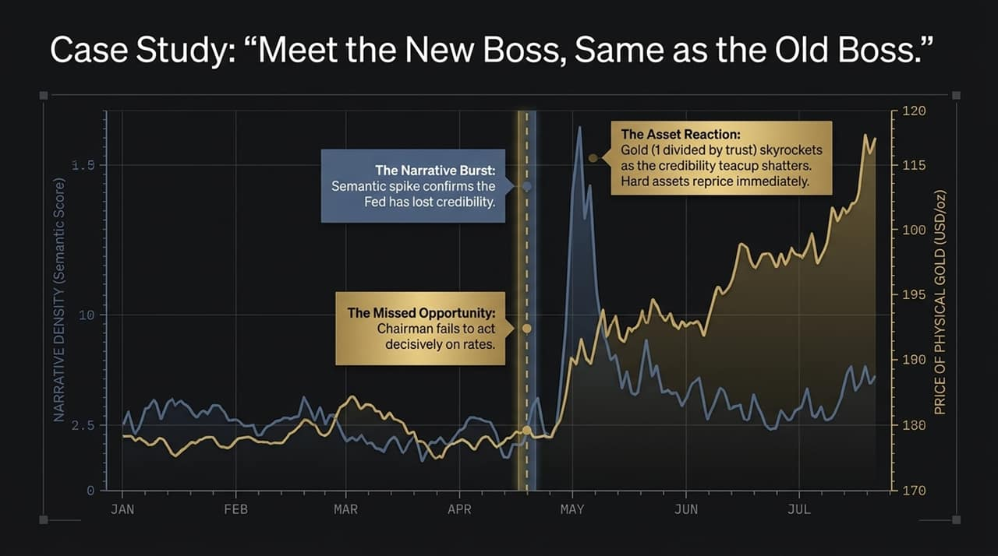
Notes:
Shifting to behavioral finance, Dave Nadig highlights a hidden, insidious risk spreading through retail markets: micro-betting and gamified trading interfaces.
A single catastrophic loss (e.g., losing $10,000 on one event) causes acute pain. The participant goes home destitute, but learns an immediate, permanent lesson.
The real danger is the 'Insidious Slow Bleed'—losing 5–10% weekly over dozens of small bets, re-funding capital, hitting an occasional win to trigger dopamine, and repeating the cycle.
This acts as a grinding tax on math literacy, slowly destroying wealth without ever delivering the shocking wake-up call required to break the habit.

Slide 11
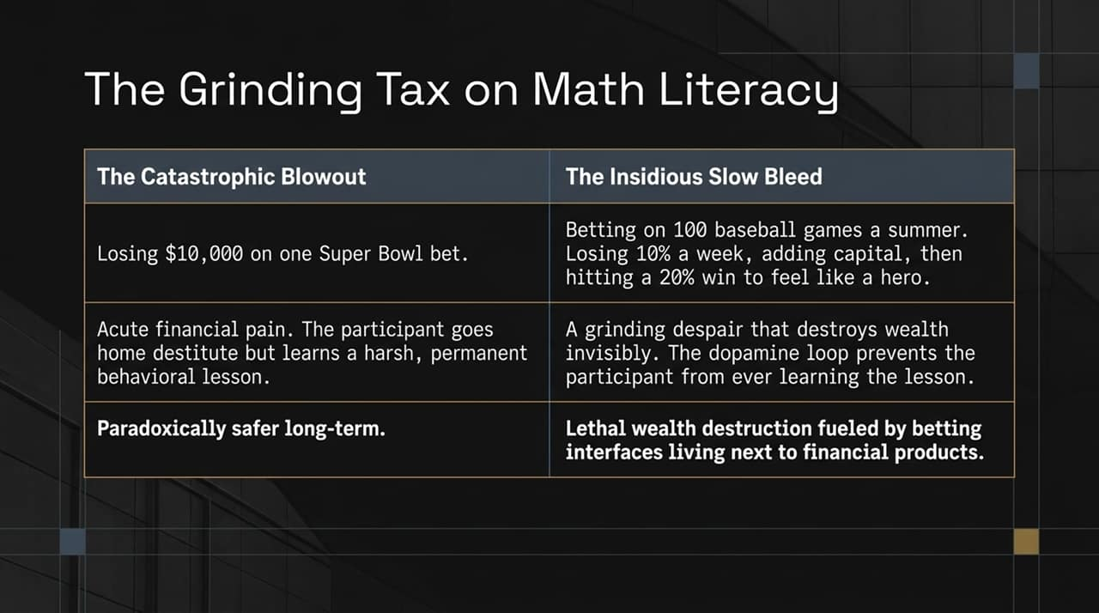
Notes:
"To evaluate behavioral trading or speculative risk, financial planners look at the capital source:
Funding via Income: If small speculative losses come out of a weekly discretionary paycheck, it functions as harmless entertainment—the rent and grocery bills are still paid.
Funding via Assets: If long-term savings or investment holdings are sold off to fund the ongoing dopamine loop, structural wealth destruction occurs.
The critical trap is that continuous income can temporarily mask the leak in draining assets, creating a false sense of security right up until retirement.

Slide 12
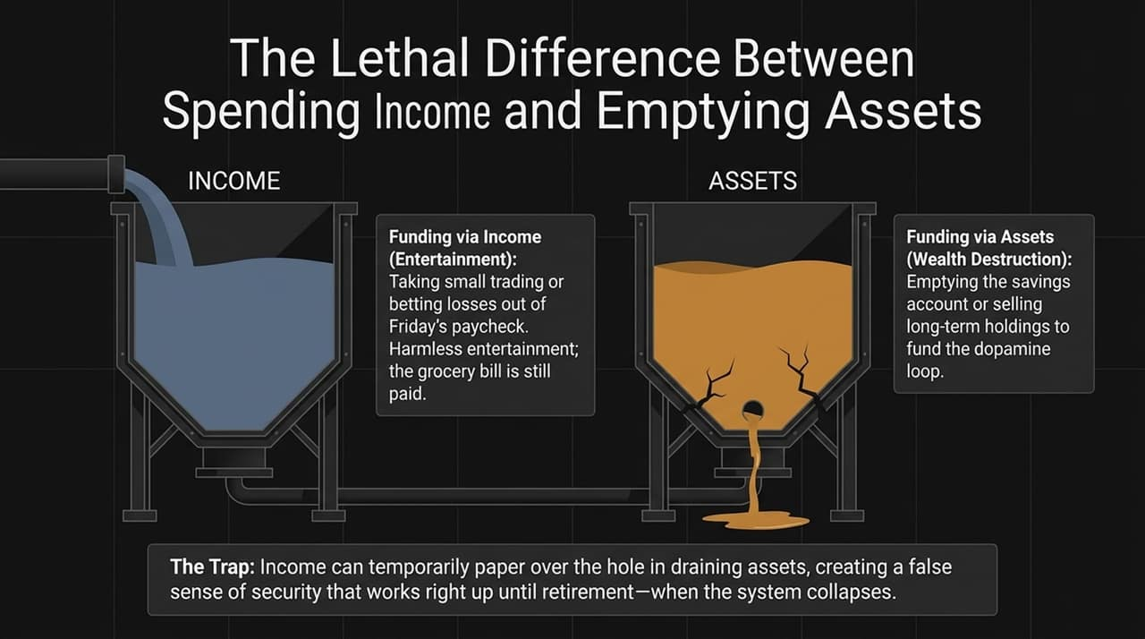
Notes:
"To wrap up our analysis across these three domains:
Watch Data, Not Deciders: Do not rely blindly on executive management or Fed leaders. Monitor cyclical accounting shifts and raw cash flow boundaries.
Track the Semantic Shift: Asset price trends follow 'Common Knowledge'. Monitor narrative density spikes before structural re-pricings occur.
Beware the Micro-Leak: Protect portfolios from the continuous behavioral leaks of gamified finance and unmanaged buy-and-hold complacency.

Slide 13
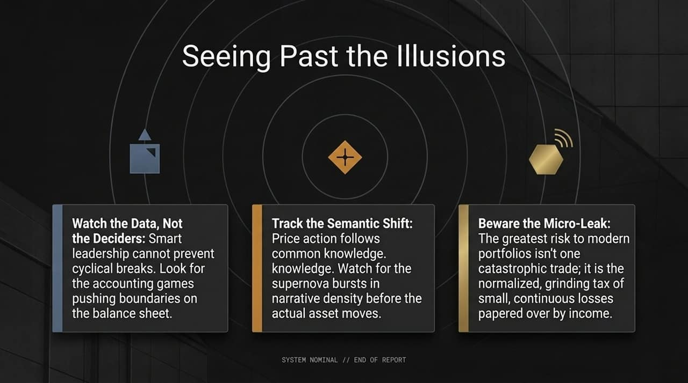
Notes:
"Looking across the broader market horizon, we must balance two simultaneous realities:
On one hand, the shift toward Agentic AI represents a genuine fundamental leap requiring massive compute intensity and delivering real productivity ROI.
On the other hand, peak-cycle accounting maneuvers and circular financing arrangements are expanding across major balance sheets."
Investors who succeed in this environment will be those who harness the fundamental upside while maintaining rigorous accounting and risk discipline.

Slide 14
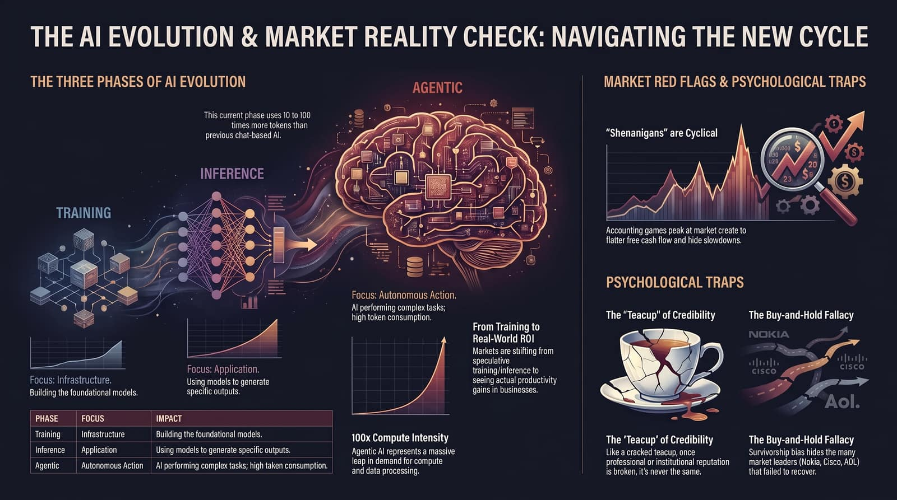
Notes:
"In conclusion, navigating today's market requires actively overcoming our psychological blind spots."
"Avoid the passive survivorship bias of assuming top market leaders remain untouchable forever. Remember that institutional credibility—like a cracked teacup—takes immense effort to repair once broken."
"By focusing on hard data, semantic narrative shifts, and strict capital allocation guardrails, investors can successfully navigate past market illusions. Thank you."

